Slide 1


San Diego County
BodyCam Storage Initiative

Slide 2
Agenda
Background/Problem Statement
Key Assumptions & Constraints
Option Overview
Questions/Discussion
Option Details
Key Requirements
Technology

Slide 3
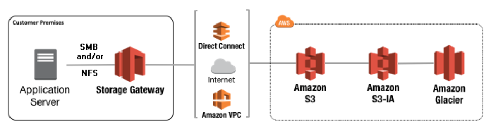
Background/Problem Statement
Axon Commander File Flow Diagram
Axon Commander app
Mp4, imd, axon-mf files created to local disk and file share
Storage gateway produces cached copy of files from file share
File gets created/modified in S3 bucket
new version of file
new version of file
Mp4, imd, axon-mf files get modified on local disk or file share
AWS Service Flow Diagram
Notes:
1. Add Animation to bring in Boxes

Slide 4
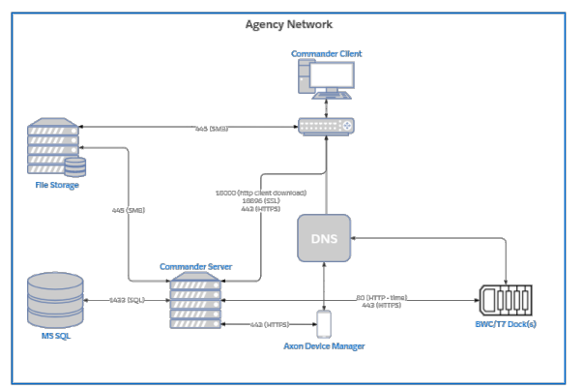
Axon Commander
Axon Commander is the SDSA File management system – The current process is that all access to video files goes through Axon
Commander can delete files:
Current cleanup process goes thru Commander → Recycle Bin→ Purges file → Copies to new Name → Initiates Delete process on original file.
If Commander can’t access the file, it could corrupt the link. (need to understand this better)
Axon is very slow to move video files: Took Commander 1 month to move 20,000 files/8 TB – Need to move 400TB
Commander stores the location of the file in its database via a full hash function
We can’t manipulate the file. New copies are a new hash

Slide 5
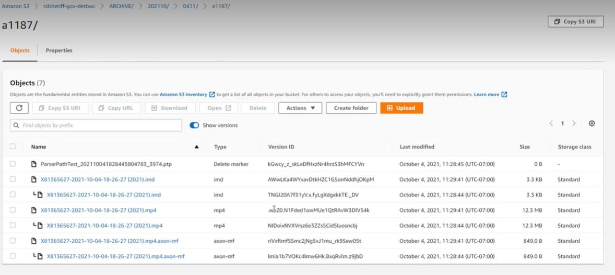
Background/Problem Statement
 | File Extension | Role
1 | .mp4 | Video file
2 | .imd | Meta data file (Time Stamp, GPS Location, etc)
3 | .axon-mf | Axon Commander chain of custody file

Slide 6
Key Requirements
 | Assumptions & Constraints
1 | Files need to be stored off premise in a secure Gov cloud
2 | Separate Evidence & Non-Evidence - Officer tags before imported/uploaded Non-Evidence – deleted in 30 days Evidence – needed possibly forever
3 | Once a video is supposed to be deleted, it needs to be gone forever and not retrievable – Could be a discovery violation
4 | Need to be able to retrieve stored videos within 2 weeks
5 | All file accesses must be archived in a single audit log
6 | There can be no manual manipulation of files
7 | Previous versions must be stored in order to protect against accidental & purposeful deletion
Notes:
Create as a table for easier reading

Slide 7
Assumptions & Constraints
 | Assumptions & Constraints
1 | SDSA needs to maintain a chain of custody of the file to prove it was handled correctly. This chain is documented in the Commander’s audit log.
2 | Can’t have an outside process that moves the files, so the solution cannot be a manual move & repoint.
3 | Axon wants to upsell to SDSA to Evidence.com, but this is not part of the roadmap.
4 | Any manual manipulation of the file could corrupt Commander’s access to it. The file would appear deleted, but actually still be in the S3 Storage. This breaks the chain of custody proof needed.
5 | Took Commander 1 month to move 20,000 files/8 TB – Need a solution to handle 400TB
6 | The system will receive ~16TB/day

Slide 8
Options Considered
 | Preferred Options | Feasibility
1 | Lifecycle policy with Intelligent Tiering and AWS S3 Backup (Preview service)
2 | Move to bucket without versioning or FSx for Windows
3 | Move to Evidence.com
Other Options Considered
Suspend on the bucket – Tried
Manually moved in background & repointed is not captured in the audit log
Volume Gateway or AWS DataSync
AWS Outposts S3
MFA Deletion – not available on gov cloud. – No manual deletion allowed, all system generated
Virtual Tape Gateway
Notes:
Separate into High Medium Low feasibility

Slide 9
Option 1 – Lifecycle Policies with Intelligent Tiering and AWS S3 Backup (Preview)
Proposed Solution | Constraints
Lifecycle policies would delete all noncurrent versions at specified interval and move files to Intelligent Tiering staggered to happen after AWS S3 Backup takes a backup to Intelligent Tiering. | SDCS still needs access to previous versions of the files, but does not need the initial duplicate version that’s created by storage gateway.
Pros | Cons
Takes away duplication of files cost. Moves storage to cheaper tiers that are noncurrent and only accessed in disaster. Lowers ongoing costs dramatically while also providing protection from disaster. | Removes previous versions of files, but shifts them to AWS S3 Backup (Preview). S3 Backup does require versioning to stay enabled thus need for staggered policy deletion after S3 Backup completes.

Slide 10
Option 2 – Move files to bucket without versioning turned on
Proposed Solution | Constraints
Files would be repointed to a S3 bucket without versioning turned on. | SDCS still needs versioning to restore files in event of malware, inadvertent deletion or breach of access.
Pros | Cons
Takes away duplication of files to reduce space and lower costs due to no duplicate storage size on an ongoing basis. | Resync of files needed. Temporary one time additional cost for syncing any existing files to new bucket.

Slide 11
Option 3 – FSx for Windows Server or File Gateway
Proposed Solution | Constraints
AWS PrivateLink connection could be leveraged over internet for encrypted private low latency path using LAN based addressing to communicate directly to AWS FSx (managed file share service for Windows Server) | SDCS still needs versioning to restore files in event of malware, inadvertent deletion or breach of access.
Pros | Cons
Solves versioning as you could leverage backups to restore single files. Reduces cost of duplicated versions. | Each file system has a limitation of 64TB. Sizing would be difficult to manage multiple file systems at scale. Labor cost increase of management at scale of many file systems.
 | The pricing is much higher for FSx multi-AZ redundancy and much higher cost than S3. Throughput costs more the higher you go in Mbps.

Slide 12
Option 4 - Move to Evidence.com
Proposed Solution | Constraints
Move to Evidence.com | SDCS still needs versioning to restore files in event of malware, inadvertent deletion or breach of access.
Pros | Cons
This is an option that would allow for all chain of custody to be relayed and no duplicate versions as its native to the application ecosystem provided by Axon. | Expensive cost prohibitive pay per retrieval and size.
 | Axon uses its own data centers, so there is no mimicked services to cloud providers. It appears to be all proprietary services they are offering designed in-house.

Slide 13
Option 5 – Suspend on Bucket
Proposed Solution | Constraints
Suspend versioning on the S3 bucket where Commander files get pushed to by Storage Gateway. | SDCS still needs versioning to restore files in event of malware, inadvertent deletion or breach of access.
Pros | Cons
Takes away duplication of files to reduce space and lower costs. | Versioning is turned off, so if versioning is needed this introduces a challenge.

Slide 14
Option 6 - Manually moved files to S3
Proposed Solution | Constraints
Files would be copied manually at scheduled interval to S3 bucket. When not going through storage gateway no duplicate version is created. | SDCS still needs versioning to restore files in event of malware, inadvertent deletion or breach of access.
Pros | Cons
Solves versioning issue. Reduces ongoing cost as files are not duplicated by storage gateway. | Does not mirror file share one for one on any create or modification to file unless scheduled interval copy is committed.
 | Cumbersome use of resource contention and time to rescan for new file updates each scheduled interval. Added loss of time cost component.
 | Commander application has no knowledge of file once it leaves file share thus breaking chain of custody.

Slide 15
Option 7 - Volume Gateway or AWS DataSync
Proposed Solution | Constraints
AWS Data Sync agent regular transfers at intervals to S3 or AWS Volume Gateway interval volume snapshots transferred to S3. | SDCS still needs versioning to restore files in event of malware, inadvertent deletion or breach of access.
Pros | Cons
Still protected by S3 durability and versions. Solves versioning but only to a set time interval. Reduction in cost for virtual appliance needed for Data Sync and versioning duplicated costs. | Regular transfer interval would need to be set.
 | Mirroring of files would not exist.
 | Chain of custody would be broken during restoration.

Slide 16
Option 8 – AWS Outposts S3
Proposed Solution | Constraints
AWS Outposts is placing identical AWS server rack used for backing S3 with identical control plane on premises for data sovereignty or compliance purposes. Not permitted to contain export-controlled data. | SDCS still needs prevention of deletion to restore files in event of malware, inadvertent deletion or breach of access.
Pros | Cons
This would potentially alleviate any internet traffic transfer congestion as the traffic would all be localized. Decrease in costs around internet traffic. | The same S3 bucket versioning issue would still exist if leveraging storage gateway to provide integration between file share and S3. Additional costs for rental of physical hardware. No protection of data center outage unless replicating to AWS based S3 bucket.

Slide 17
Option 9 - MFA Deletion
Proposed Solution | Constraints
Files in S3 bucket would require MFA device code or approval prior to deletion. Currently not available in govcloud, but may be in future. | SDCS still needs prevention of deletion to restore files in event of malware, inadvertent deletion or breach of access.
Pros | Cons
Prevents files from being deleted inadvertently. Does not change any ongoing cost. | Does not solve versioning duplicate file issue. Not available in govcloud.

Slide 18
Option 10 – Virtual Tape Gateway
Proposed Solution | Constraints
Virtual Tape Gateway would take backups from on-prem backup software and move them to Glacier for retrieval as needed by backup software. | Mirroring component needed from file share to S3 bucket.
Pros | Cons
Takes away duplication of files. Reduces costs as files can be moved via policy to cheaper tiers with no issue of duplication. | Not recommended due to retrieval issues from backup software. Requires compatible backup software. No mirroring of file shaer component only point and time recoveries.

Slide 19
Open Slide

Slide 20

Thank You!

Slide 21
Appendix

